Slide 1
🟦 Day 1 – .NET & C# Fundamentals (Must-Answer Questions)

Slide 2
Agenda
Day 1 – .NET & C# Fundamentals (Must-Answer Questions) Focus: Baseline questions interviewers expect you to answer confidently What is .NET? Difference between .NET Framework / .NET Core / .NET What is IL (Intermediate Language)? What is CLR? What is managed code vs unmanaged code? Why is .NET called a managed environment? 👉 How to explain in interviews (simple + confident) 👉 Follow-up questions interviewers usually ask

Slide 3
What is .NET?
✅ Simple Interview Answer
.NET is a free, open-source development platform from Microsoft used to build different types of applications like web, desktop, cloud, mobile, and APIs using languages like C#.
💡 If interviewer asks “platform means?”
It provides:
Runtime (CLR)
Libraries (Base Class Library)
Languages (C#, F#)
Tools (Visual Studio)

Slide 4
What is .NET?
C# Code
↓
.NET Platform
↓
CLR + Libraries
↓
OS (Windows / Linux / Mac)
Follow-up Questions
Is .NET only for Windows? ❌
Which languages support .NET?
Is .NET free?

Slide 5
Difference: .NET Framework vs .NET Core vs .NET
✅ Short Interview Explanation
.NET Framework was Windows-only. .NET Core was cross-platform. .NET is the unified, modern version that replaced both.
. NET Framework → Windows only
.NET Core → Cross-platform
.NET (5+) → Unified platform
🔁 Follow-up Questions
Why did Microsoft create .NET Core?
Is .NET Framework still used?
Which one should we use for new projects?

Slide 6
What is IL (Intermediate Language)?
✅ Simple Interview Answer
IL is an intermediate code generated from C# code, which is later converted into machine code by the CLR at runtime.
IL makes .NET language-independent.
C# Code
↓
IL Code
↓
CLR(JIT)
↓
Machine Code
Follow-up Questions
Who converts IL to machine code?
Why not convert directly to machine code?
Is IL same for all languages?

Slide 7
What is CLR?
CLR (Common Language Runtime) is the execution engine of .NET that runs IL code and provides services like memory management, garbage collection, exception handling, and security.
What CLR Does
Converts IL (half compiled)→ Machine code
Manages memory (GC)
Handles exceptions
Enforces type safety
Follow-up Questions
What is JIT?(diffrent ways per file,per function etc)
Does CLR handle memory automatically?
Is CLR present in .NET Framework and .NET?

Slide 8
Managed Code vs Unmanaged Code
Interview Answer (Very Important)
Managed code runs under CLR control, while unmanaged code runs directly on the OS without CLR support.
Managed | Unmanaged
Runs under CLR | Runs directly on OS
Automatic memory | Manual memory
Safer | Risky
Follow-up Questions
Can managed code call unmanaged code?
What is P/Invoke?
Why use unmanaged code?
Real Example (Interview Gold)
C#, VB → Managed
C, C++ → Unmanaged

Slide 9
Why is .NET called a Managed Environment?
Perfect Interview Answer
.NET is called a managed environment because the CLR manages memory, execution, security, and exceptions automatically.
🧠 Key Word to Emphasize
👉 “CLR manages the lifecycle of code execution.”
🔁 Follow-up Questions
What happens if memory is not managed?
What is Garbage Collection?
Is GC manual or automatic?
Technology | Latest Version | Release | Support
.NET | .NET 10 | Nov 2025 | LTS (supported until Nov 2028)
C# | C# 14 | Released with .NET 10 | Latest language version

Slide 10
🟦 Day 2 – .NET & C# Fundamentals (Must-Answer Questions)

Slide 11
Agenda
Day 2– Memory & Type System (Very High Impact) These are deal-breaker questions if answered poorly. Stack vs Heap (with real example) Value types vs Reference types What happens in memory when an object is created? Why structs are stored differently from classes What is boxing and unboxing? Performance impact of boxing 👉 Whiteboard-style explanation 👉 Real project examples (method calls, parameters)

Slide 12
Stack vs Heap (Concept)
Stack
Fast memory allocation
Stores:
Local variables
Method parameters
Value types (mostly)
Memory cleared automatically when method exits
Heap
Slower than stack
Stores:
Objects (reference types)
Arrays, strings, class instances
Managed by Garbage Collector (GC)

Slide 13
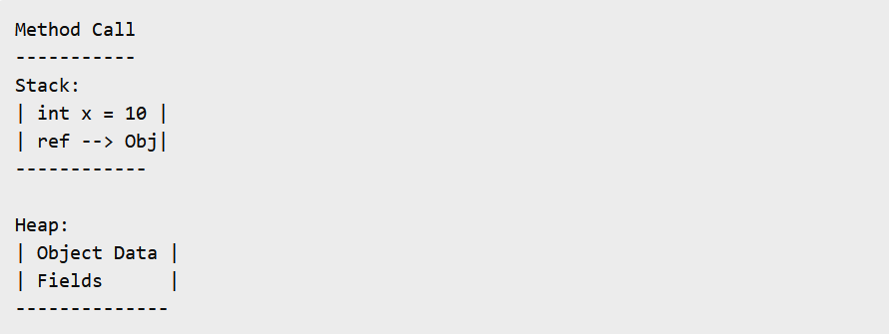
Stack vs Heap (Concept)
Stack stores reference, not the actual object
Heap stores the actual object data

Slide 14
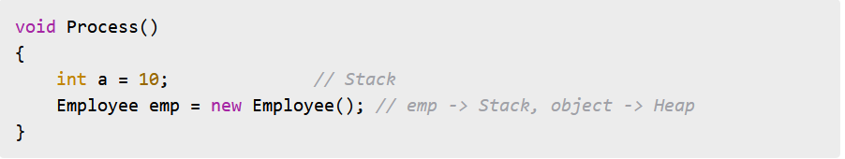
Stack vs Heap (Real Example)
Memory Flow
a stored directly in stack
emp reference stored in stack
Employee object stored in heap

Slide 15
Value Types vs Reference Types
Value Types
Stored directly in memory location
Copy by value
Examples:
int, double, bool
struct, enum
Reference Types
Stored in heap
Stack holds reference
Copy by reference
Examples:
class, array, string, object

Slide 16
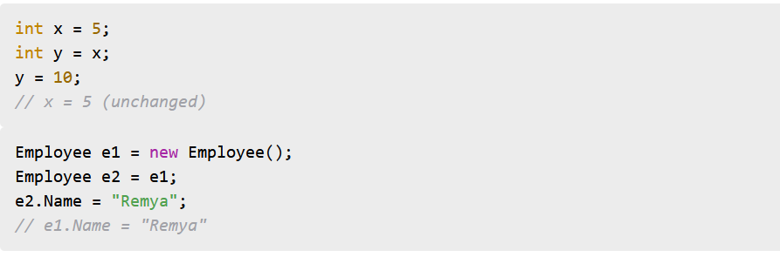
Value vs Reference (Code Example)
Key Interview Line
Value types copy data, reference types copy address.

Slide 17
Memory Lifecycle of an Object
Object lives in heap
Stack reference goes out of scope
Object becomes eligible for GC
GC cleans it during collection
❗ GC is non-deterministic

Slide 18
What Happens When an Object Is Created?
Step-by-step
Stack allocates space for emp (reference)
Heap allocates memory for Employee object
Constructor initializes fields
Stack variable points to heap object

Slide 19
Why Structs Are Stored Differently from Classes
Struct
Value type
Stored on stack (usually)
No GC overhead
Cannot be null
Class
Reference type
Stored on heap
GC managed
Can be null
Use Struct When
Small data
Immutable data
Short-lived
High-performance scenarios
Use Class When
Large objects
Complex behavior
Shared state

Slide 20
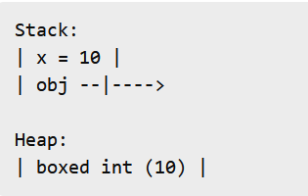


Boxing & Unboxing (Concept) (Memory View)
Boxing
Converting value type → reference type
Unboxing
Reference type → value type
Boxing creates new object in heap
Copy happens both ways

Slide 21
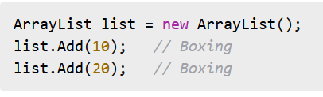
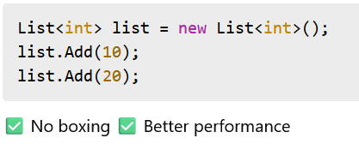
Performance Impact of Boxing Real Project Example
Why Boxing Is Bad
Heap allocation
GC pressure
Extra CPU cycles
Real Impact
Loops
Collections
High-frequency method calls

Slide 22
Whiteboard Summary (Must Say in Interview)
Stack = fast, short-lived
Heap = objects, GC managed
Value types copy data
Reference types copy address
Boxing = performance killer

Slide 23
🟦 Day 3 – .NET & C# Fundamentals (Must-Answer Questions)

Slide 24
Agenda
Day 3– OOPs (Asked in Every Interview) Focus: How to explain using your project Explain Encapsulation, Inheritance, Polymorphism, Abstraction Real project example for each OOP concept Interface vs Abstract class When would you choose interface over abstract class? Can a class implement multiple interfaces?

Slide 25
What Interviewers ask for
Do you understand why OOP exists?
Can you map concepts to real project code?

Slide 26
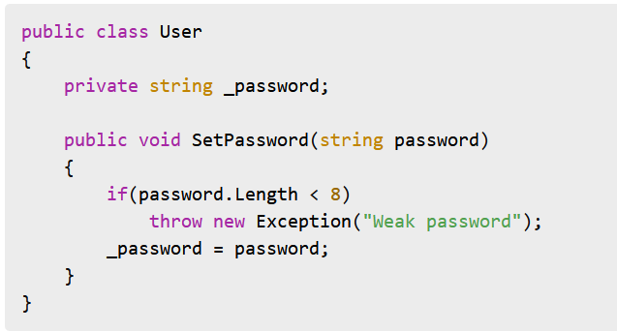
Encapsulation (Concept)
Real Project Eg
Definition
Encapsulation means:
Hiding internal implementation
Exposing only what is required
Protecting object state
Key line: Encapsulation is about controlling access,
not just using private variables.
From our Project
Examples you can mention:
DTOs exposing only required fields
Private setters with public getters
Service classes hiding DB logic
“UI doesn’t know how data is saved – it only calls the service.”
Explanation in Interview
Password is hidden
Validation logic controlled inside class
Prevents invalid object state

Slide 27
Encapsulation (Concept)
Encapsulation is the process of bundling data and the methods that operate on that data into a single unit and restricting direct access to the internal data by providing controlled access through methods.
Encapsulation is hiding an object's internal state/implementation and exposing a controlled interface to interact with it.

Slide 28
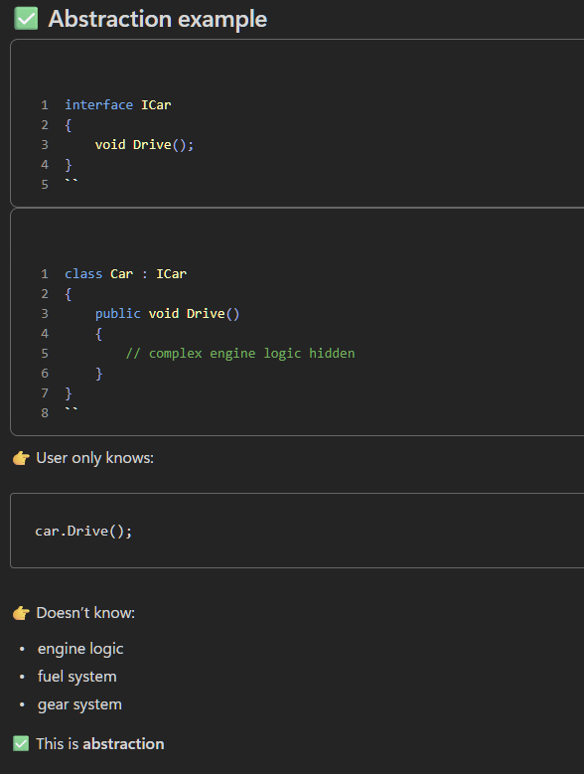
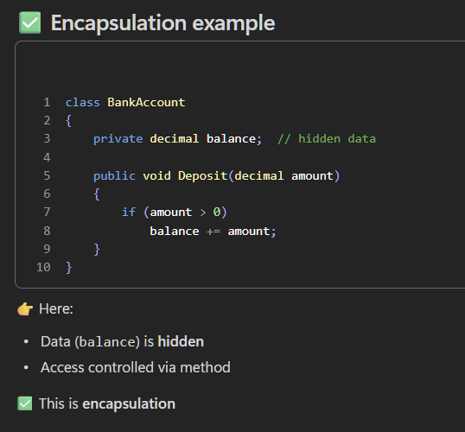
Difference between Abstraction and Encapsulation

Slide 29
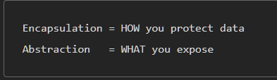
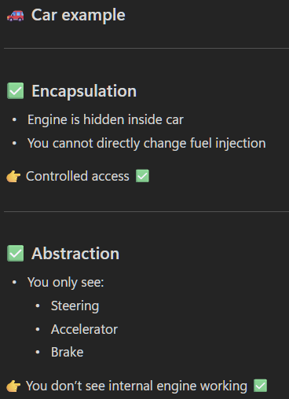
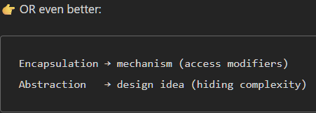
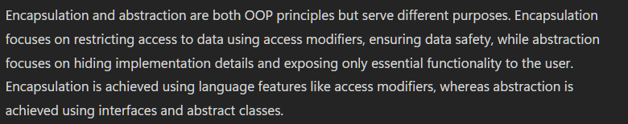
Difference between Abstraction and Encapsulation
Encapsulation hides data, abstraction hides complexity.

Slide 30
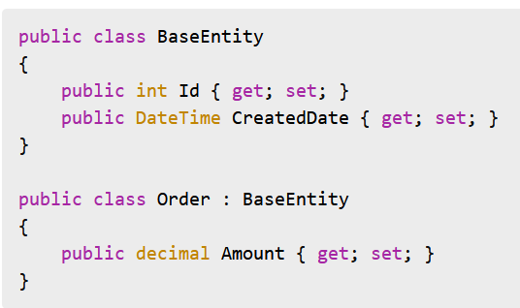
Inheritance (Concept)
Real Project Eg
Definition
Inheritance allows:
Reusing common behavior
Establishing IS-A relationship
Key line: Inheritance promotes reuse but should be used carefully.
Interview Explanation
Common fields reused
Avoids duplication
Ensures consistency

Slide 31
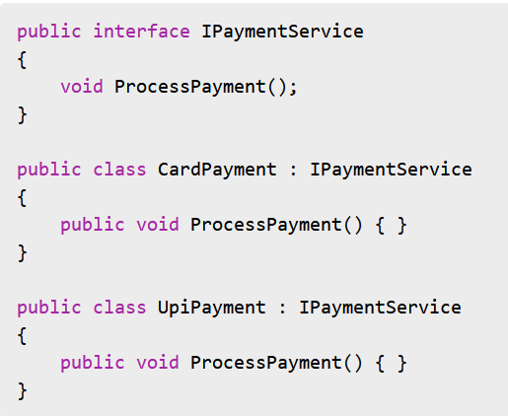
Polymorphism (Concept)
Real Project Eg
Polymorphism allows:
Same interface
Different behavior
Same method call, different execution.

Slide 32
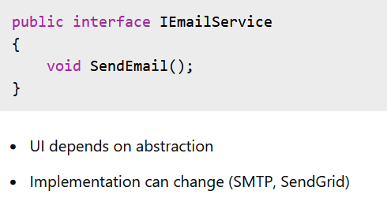
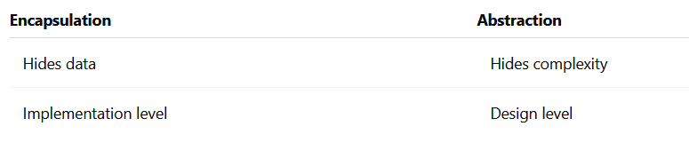
Abstraction (Concept)
Real Project Eg
Abstraction focuses on:
What an object does
Not how it does it
Abstraction reduces complexity.
Abstraction vs Encapsulation

Slide 33
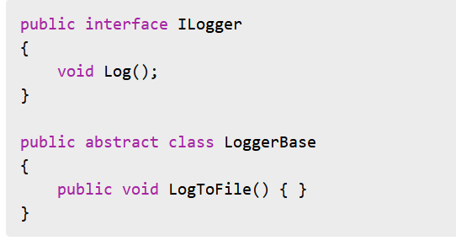
Interface vs Abstract Class
Interface vs Abstract (Code View)
Interface
Contract only
No state
Multiple inheritance supported
Abstract Class
Partial implementation
Can have state
Single inheritance only

Slide 34
When to Choose Interface Over Abstract Class
Interface vs Abstract (Code View)
Choose Interface when:
Multiple inheritance needed
No shared code
Loose coupling required
Plugin-based architecture
Common in ASP.NET Core DI
When to Choose Abstract Class
Choose Abstract Class when:
Shared base logic exists
Controlled inheritance hierarchy
Common fields required

Slide 35
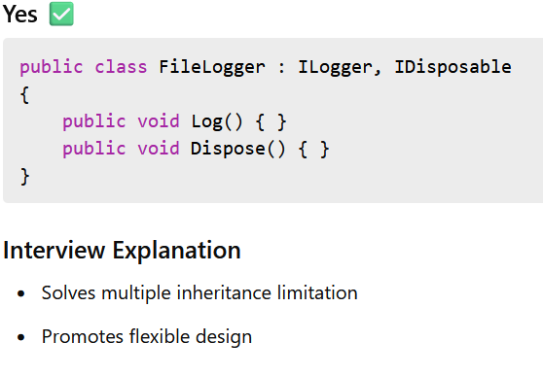
Can a Class Implement Multiple Interfaces?
Interface vs Abstract (Code View)

Slide 36
OOPs Whiteboard Summary
Encapsulation → Protect data
Inheritance → Reuse behavior
Polymorphism → Runtime behavior
Abstraction → Reduce complexity
Good design uses all four together.

Slide 37
1️⃣ Thread
A Thread represents an actual OS-level thread that executes code.
It is low-level.
You manually manage the thread (start, stop, etc.).
Creating many threads can be expensive in terms of memory and performance.

Slide 38
using System;
using System.Threading;
class Program
{
static void PrintNumbers()
{
for (int i = 1; i <= 5; i++)
{
Console.WriteLine("Thread: " + i);
Thread.Sleep(500);
}
}
static void Main()
{
Thread thread = new Thread(PrintNumbers);
thread.Start();
Console.WriteLine("Main method finished");
}
}
A new OS thread is created.
PrintNumbers runs on that thread.
The main thread continues execution.

Slide 39
2️⃣ Task
A Task is a higher-level abstraction for asynchronous work.
Part of Task Parallel Library (TPL).
Uses ThreadPool internally.
More efficient and easier to manage.
Supports async/await, continuations, cancellation, etc.

Slide 40
using System;
using System.Threading.Tasks;
class Program
{
static void PrintNumbers()
{
for (int i = 1; i <= 5; i++)
{
Console.WriteLine("Task: " + i);
Task.Delay(500).Wait();
}
}
static void Main()
{
Task task = Task.Run(() => PrintNumbers());
Console.WriteLine("Main method finished");
task.Wait();
}
}
What happens
Task.Run() schedules the work on a ThreadPool thread.
No need to manually create or manage threads.

Slide 41
🟦 Day 4 – .NET & C# Fundamentals (Must-Answer Questions)

Slide 42
Agenda
Day 4– SOLID & Design Thinking What are SOLID principles? Which SOLID principle have you actually used? Open–Closed principle with real example Dependency Inversion explained simply Common design mistakes in real projects

Slide 43
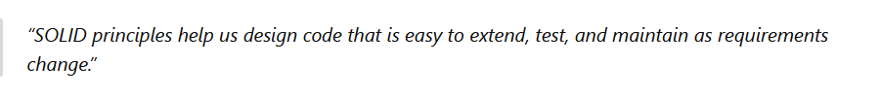
What are SOLID principles?
What Is SOLID?
SOLID is a set of design principles that help you:
Write maintainable code
Reduce coupling
Increase flexibility
Handle change safely
SOLID stands for
S – Single Responsibility Principle
O – Open–Closed Principle
L – Liskov Substitution Principle
I – Interface Segregation Principle
D – Dependency Inversion Principle

Slide 44
Which SOLID Principles Have You Actually Used?
Honest & Strong Answer
Single Responsibility → Very frequently
Open–Closed → Frequently
Dependency Inversion → Almost everywhere (DI)
Interface Segregation → While designing APIs
Liskov Substitution → Implicitly via polymorphism
Interviewers like practical honesty, not perfection.

Slide 45
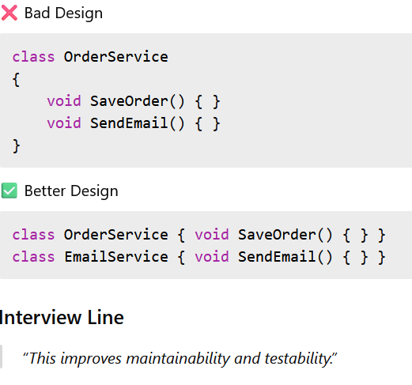
Single Responsibility Principle (SRP)
A class should have only one reason to change.

Slide 46
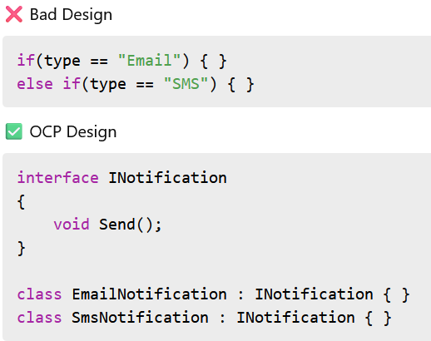
Open–Closed Principle (Concept)
Open for extension
Closed for modification
Add new behavior without changing existing code.
“When a new notification type comes, I just add a new class. Existing code remains untouched.”
This shows:
Low risk
Fewer bugs
Better extensibility

Slide 47
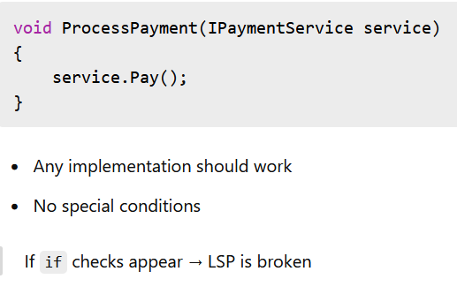
Liskov Substitution Principle
Derived classes must be replaceable for their base class.
Child should not break parent behavior.

Slide 48
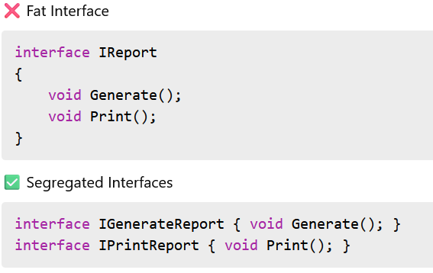
Interface Segregation Principle (ISP)
Clients should not be forced to depend on methods they don’t use.

Slide 49
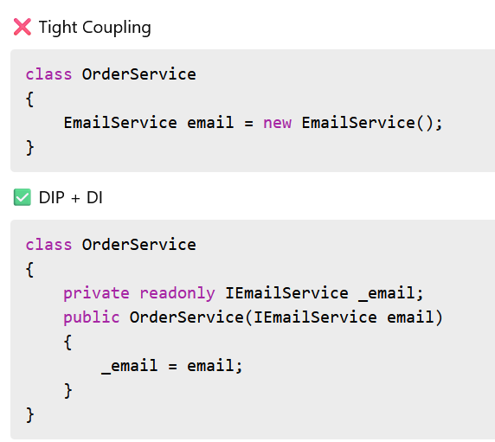
Dependency Inversion Principle
High-level modules should not depend on low-level modules. Both should depend on abstractions.
Or simply:
Depend on interfaces, not concrete classes.

Slide 50
Why DIP Matters in Real Projects
Easy unit testing (mocking)
Replace implementations
Loose coupling
Core of ASP.NET Core Dependency Injection

Slide 51
Common Design Mistakes in Real Projects
❌ God classes ❌ Too many responsibilities ❌ Tight coupling ❌ No interfaces ❌ Overusing inheritance ❌ Copy-paste logic
How SOLID Prevents These Mistakes
SRP → Smaller classes
OCP → Safer changes
DIP → Loose coupling
ISP → Clean APIs
LSP → Reliable polymorphism

Slide 52
🟦 Day 5 – .NET & C# Fundamentals (Must-Answer Questions)

Slide 53
Agenda
Day 5– C# Advanced & Runtime Behavior Focus: Questions interviewers ask when they go deeper IEnumerable vs IQueryable Deferred vs Immediate execution How does Garbage Collection work? What is IDisposable? How do you handle exceptions in real projects? Difference between throw and throw ex

Slide 54
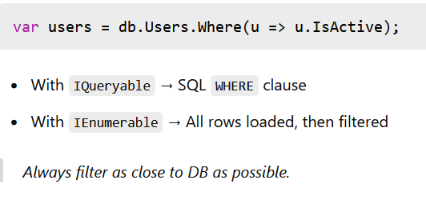
IEnumerable vs IQueryable (Concept)
IEnumerable vs IQueryable (Real Example)
IEnumerable
Works with in-memory collections
Executes query in application memory
Suitable for small data sets
IQueryable
Works with data sources (DB)
Executes query at data source level
Suitable for large data sets

Slide 55
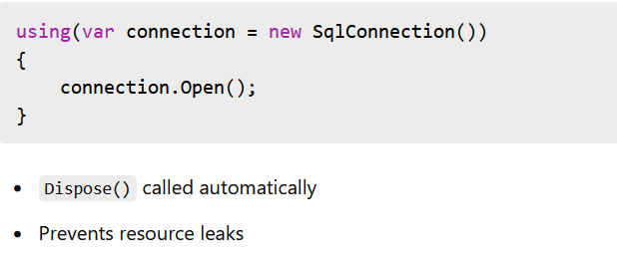
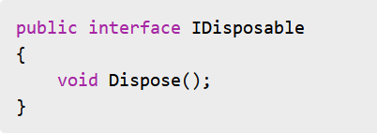
What Is IDisposable?
IDisposable (Real Example)
Purpose
Release unmanaged resources
Files, DB connections, streams

Slide 56
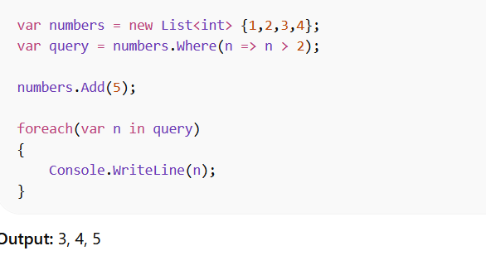
Deferred Execution (LINQ)
Query is not executed immediately.
Executes only when the data is iterated (foreach, ToList, etc.).
Reflects latest changes in the collection.

Slide 57
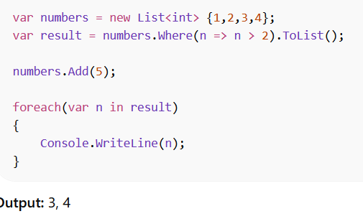
Immediate Execution (LINQ)
Query executes immediately.
Uses methods like ToList(), ToArray(), Count().
Result is stored in memory.

Slide 58
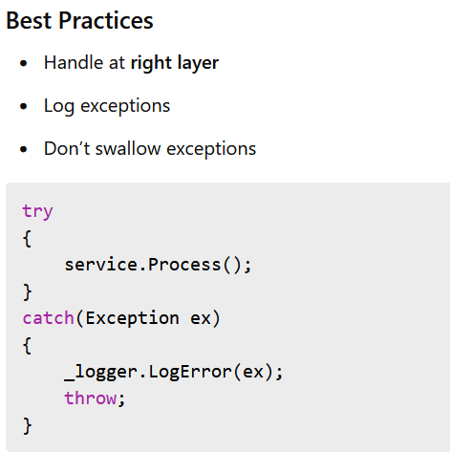
Exception Handling (Real Projects)
Global Exception Handling
Middleware in ASP.NET Core
Filters for MVC
Centralized handling improves consistency

Slide 59
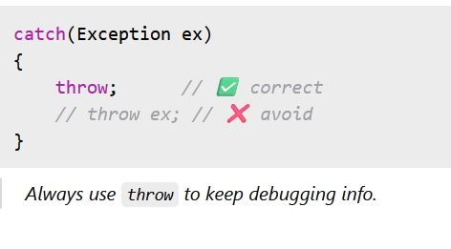
throw vs throw ex (Very Common Question)
throw
Preserves original stack trace
throw ex
Resets stack trace
throw vs throw ex (Example)

Slide 60
🟦 Day 6 – SQL Fundamentals (Must-Answer Questions)

Slide 61
Agenda
Day 6– SQL Fundamentals (Interview Style) Focus: Query thinking, not syntax How do you design a database? Primary key vs Unique key Foreign key usage in real systems Difference between DELETE, TRUNCATE, DROP How do you handle NULLs? 👉 Interviewer expectations for backend developers

Slide 62
How Do You Design a Database?
Practical Steps
Understand business requirements
Identify entities (tables)
Define relationships
Choose correct keys
Normalize (then denormalize if needed)
Real Project Example
Order Management System
Customer
Order
OrderItems
Product
👉 One customer → many orders 👉 One order → many items
Interview line:
“I start with business flows, identify entities, define relationships, and then design keys based on access patterns.”

Slide 63
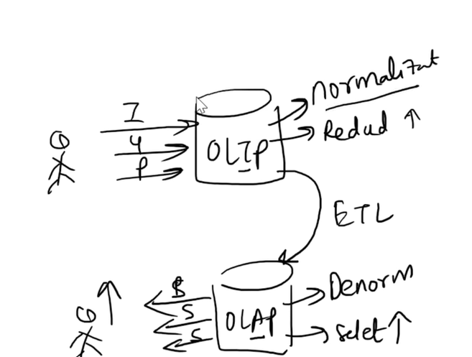
OLTP(on;ine transaction processing system) and OLAPS(online analytical processing system)

Slide 64
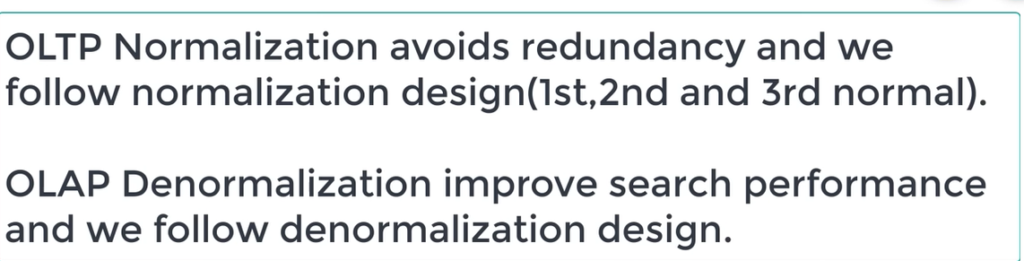
OLTP(online transaction processing system) and OLAPS(online analytical processing system)

Slide 65
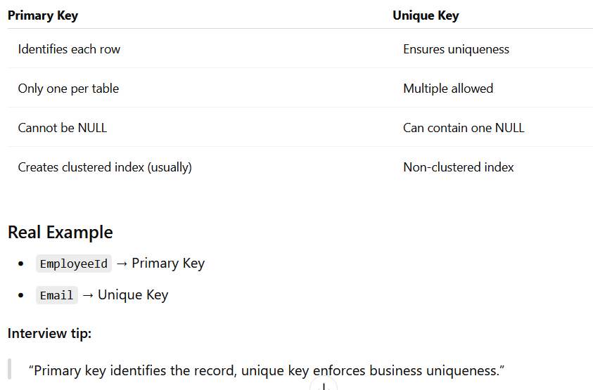
Primary Key vs Unique Key

Slide 66
Foreign Key Usage in Real Systems
Why Use Foreign Keys?
Enforce data integrity
Prevent orphan records
Improve data consistency
Example
Interview line:
“Foreign keys protect data integrity, but in high-performance systems we balance FK usage with application-level validation.”

Slide 67
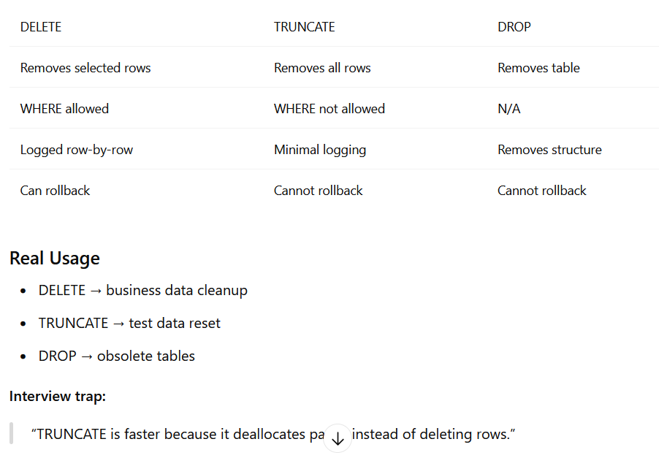
DELETE vs TRUNCATE vs DROP

Slide 68

How Do You Handle NULLs?
Key Points
NULL ≠ empty or zero
Comparisons with NULL require IS NULL
Common Handling
Real Scenario
Nullable fields for optional data
Avoid NULLs in calculations
Interview line:
“I handle NULLs explicitly to avoid incorrect aggregations and unexpected query results.”

Slide 69
🟦 Day 7 – SQL Fundamentals (Must-Answer Questions)

Slide 70
Agenda
Day 7– SSQL Query Questions (Very Common) Hands-on interview query patterns Find duplicate records INNER JOIN vs LEFT JOIN (with example) WHERE vs HAVING Fetch latest record per group Count records per category

Slide 71
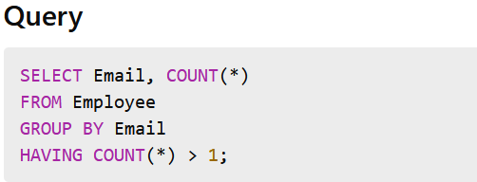
Find Duplicate Records
Question
Find duplicate emails in Employee table.
Thinking Process
Duplicates mean COUNT > 1
Need GROUP BY

Slide 72
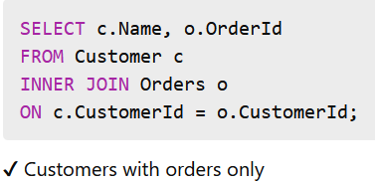
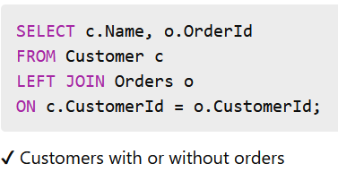
INNER JOIN vs LEFT JOIN
Scenario
Customer and Orders tables
INNER JOIN
Returns matching records only
LEFT JOIN
Returns all left table records
Interview Line:
"INNER JOIN filters unmatched rows, while LEFT JOIN preserves all left-side records."

Slide 73
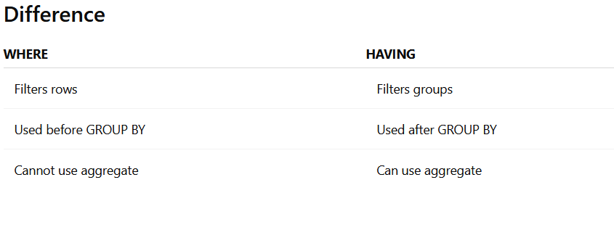
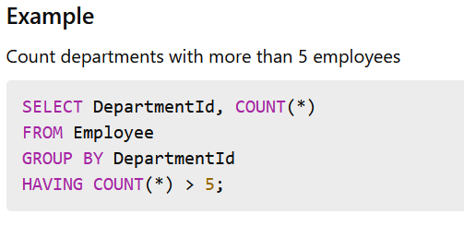
WHERE vs HAVING
Interview Line:
"WHERE filters raw rows, HAVING filters aggregated results."

Slide 74
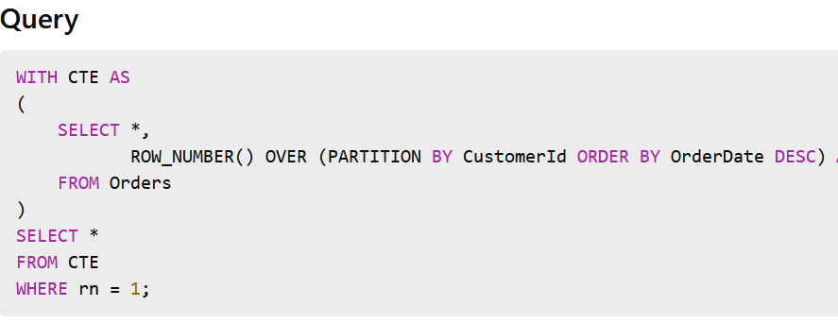
Fetch Latest Record Per Group
Scenario
Get latest order per customer
Thinking
Partition by CustomerId
Order by OrderDate DESC
Use ROW_NUMBER()
Interview Explanation:
"I partition by customer, sort by date descending, and select first row per group."

Slide 75
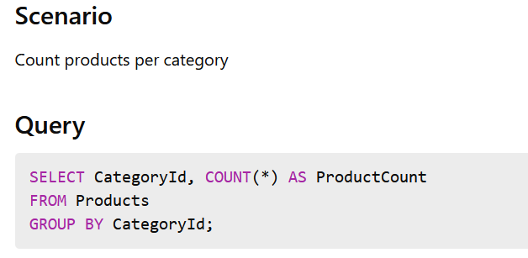
Count Records Per Category

Slide 76
Clustered Index
Data is physically sorted in the table.
Table can have only ONE clustered index.
Faster for range queries.
CREATE TABLE Students (
Id INT PRIMARY KEY, -- Clustered Index
Name VARCHAR(50),
Marks INT
);

Slide 77
Non-Clustered Index
Data is not physically sorted.
Creates a separate structure (index + pointer).
Table can have multiple non-clustered indexes.
CREATE NONCLUSTERED INDEX idx_name
ON Students(Name);

Slide 78
🟦 Day 8 – SQL Fundamentals (Must-Answer Questions)

Slide 79
Agenda
Day 8– Advanced SQL Interview Questions Focus: What impresses interviewers Subquery vs Join – when to use what What is CTE? Why CTE improves readability ROW_NUMBER vs RANK Pagination query patterns

Slide 80
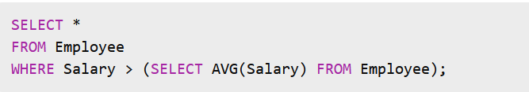
Subquery vs Join – When to Use What
Subquery
A query inside another query.
Example
Get employees who earn more than average salary:
When to Use Subquery
Single value comparison
EXISTS / NOT EXISTS checks
Simple filtering logic

Slide 81
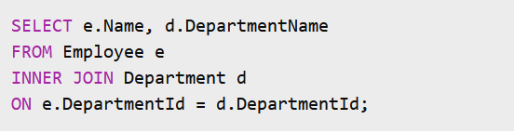
Subquery vs Join – When to Use What
Join
Combines data from multiple tables.
Example
Get employee with department name:
When to Use Join
Retrieving columns from multiple tables
Reporting queries
Aggregated results with grouping
Interview-Level Answer
"I use subqueries for value-based filtering and EXISTS checks. I prefer joins when retrieving related data across tables for better readability and optimization."

Slide 82
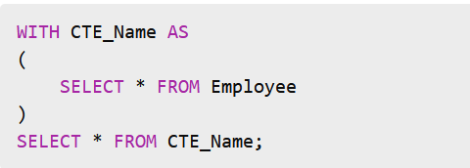
What is a CTE?
CTE (Common Table Expression) is a temporary result set defined using WITH clause.
Syntax
Why CTE is Used
Break complex queries into logical parts
Improve readability
Reuse result within same query
Helpful for recursion

Slide 83
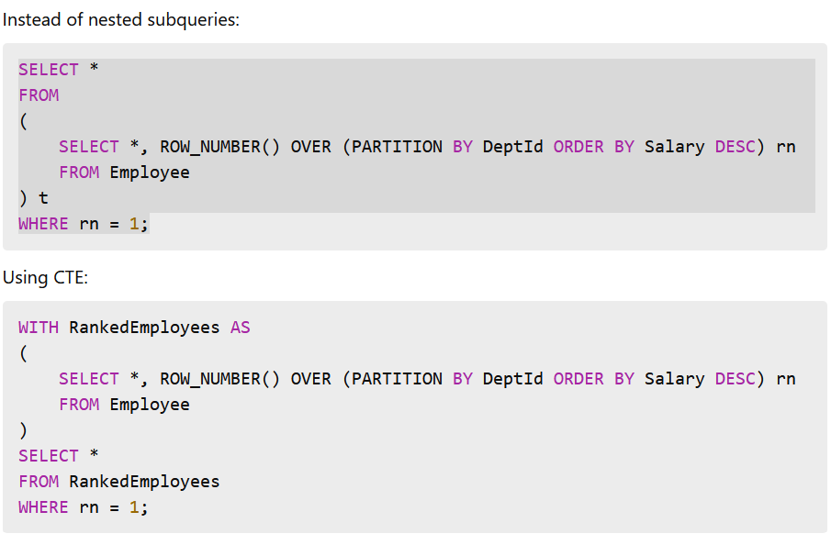
Why CTE Improves Readability

Slide 84
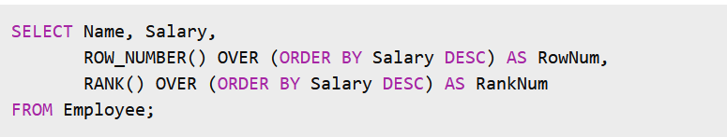
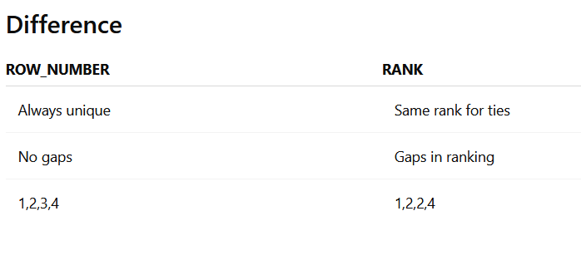
ROW_NUMBER vs RANK
Both are window functions.
Example Data (Salary Ranking)

Slide 85
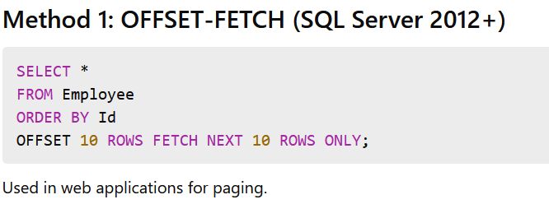

Pagination Query Patterns

Slide 86
🟦 Day 9 – NET Application & Project Explanation

Slide 87
Agenda
Day 9– .NET Application & Project Explanation Focus: “Tell me about your project” End-to-end application flow Layered architecture explanation ADO.NET vs Entity Framework Code First vs DB First Lazy loading – real problems & fixes How you improved performance in your project 👉 Turning your experience into strong answers

Slide 88
How to Start – Strong Opening Structure
🎤 Recommended Structure (2–3 Minutes Answer)
Project domain + purpose
Tech stack used
Architecture overview
Your role & responsibilities
Performance improvements / challenges solved

Slide 89
End-to-End Application Flow
Example Flow (Typical .NET Web Application)
User sends request (UI – Angular / MVC / React)
Controller receives request
Service layer handles business logic
Repository layer interacts with DB
Database returns data
Response mapped to DTO
Sent back to UI
🎤 Interview Line:
"The request flows from presentation layer to service layer, then repository, and finally to SQL Server, maintaining separation of concerns."

Slide 90
Layered Architecture Explanation
Typical Layers
• Presentation Layer (UI / Controllers)
• Business Layer (Services)
• Data Access Layer (Repository / EF / ADO.NET)
• Database Layer (SQL Server)
Why Layered Architecture?
✔ Separation of concerns ✔ Testability ✔ Maintainability ✔ Scalability
🎤 Interview Line:
"We followed clean layered architecture to keep business logic independent from UI and database logic."

Slide 91

ADO.NET vs Entity Framework
🎤 When I Used ADO.NET:
Performance-critical queries
Bulk operations
🎤 When I Used EF:
Rapid development
Standard CRUD operations

Slide 92
Code First vs DB First
Code First
Models defined in C#
DB generated via migrations
Good for new projects
DB First
Database already exists
Generate models from DB
Good for legacy systems
🎤 Interview Line:
"In greenfield projects, I prefer Code First. In legacy enterprise systems, DB First is more practical."

Slide 93
Lazy Loading – Real Problems & Fixes
What is Lazy Loading?
Related data is loaded only when accessed.
Real Problem (N+1 Issue)
Multiple DB calls inside loops
Performance degradation
Fixes
✔ Use Include() for eager loading ✔ Use projection (Select DTO) ✔ Disable lazy loading when not required
🎤 Interview Line:
"We identified N+1 query issues using SQL profiler and optimized using eager loading."

Slide 94
How I Improved Performance in My Project
Examples You Can Mention:
✔ Added indexes on frequently filtered columns
✔ Replaced nested queries with optimized joins
✔ Converted LINQ queries to stored procedures
✔ Reduced API response size using DTO projection
✔ Implemented caching for static data
✔ Used async/await for scalability
✔ Optimized pagination queries
🎤 Strong Statement:
"Performance improvement was achieved by analyzing slow queries and optimizing both database indexing and application-level query design."

Slide 95
Turning Experience into Strong Answers
Instead of saying: ❌ "I worked on backend development."
Say: ✔ "I designed REST APIs, optimized SQL queries, implemented layered architecture, and improved response time by 30% through indexing and query tuning."

Slide 96

Final 1-Minute Powerful Project Summary

Slide 97
🟦 Day 10– Mock Interview

Slide 98
Agenda
Day 10– Full Mock Interviews Middleware Exactly like a real interview: C# fundamentals rapid-fire SQL live query round

Slide 99

What is Middleware in .NET Core?
How Middleware Works
Request Flow:
Client → Middleware 1 → Middleware 2 → Middleware 3 → Controller → Response → Middleware 3 → Middleware 2 → Middleware 1 → Client
It works like a chain.

Slide 100

Where Is It Configured?
In ASP.NET Core 6+ it’s configured in Program.cs.

Slide 101

Use() processes request and passes control to next middleware. Run() terminates the pipeline. Map() branches the pipeline based on request path.

Slide 102
Title Slide
Full Mock Interview Session C# | SQL | .NET Real Interview Simulation
By: Remya Senior .NET Developer – IBM
Session Agenda
Real Interview Rules
C# Rapid-Fire Round
SQL Live Query Round
Project Discussion
Feedback & Improvement Areas

Slide 103
Project Round
Ask each student:
Explain your project architecture.
What was your role?
Biggest challenge?
How did you optimize database?
Any production issue?

Slide 104
Interview Rules
Answer clearly and confidently
No long storytelling
If you don’t know → say honestly
Think before answering
Real-time evaluation
C# Rapid Fire (Round 1)
What is CLR?
Value type vs Reference type?
Difference between abstract class and interface?
What is boxing and unboxing?
What is the difference between IEnumerable and IQueryable?

Slide 105
C# Rapid Fire (Round 2 – Slightly Advanced)
What is dependency injection?
What is garbage collection?
Scenario-Based Questions
How do you handle global exception handling?
How do you optimize Application performance?
How to avoid memory leaks?
Explain a production issue you solved.

Slide 106
SQL Query Round 1
Table: Employee
| Id | Name | Salary | JobId |
Questions:
Find 2nd highest salary.
Find duplicate records.
Count employees department-wise.
Find employees earning above average salary.
SQL Query Round 2 (Joins)
Tables: Orders & Customers
Get all customers with orders.
Get customers with no orders.

Slide 107
Evaluation Criteria
Technical clarity
Communication
Confidence
Practical examples
Problem-solving ability
🚀 Bonus (Professional Touch)
End with:
“Interviews don’t reject people for lack of knowledge. They reject people for lack of clarity.”
This gives impact.
Final Feedback
Strengths:
Improvement areas:
Next 30-day action plan

Slide 108
Thank you
REMYA MOHAN
Mentor-Led Interview Trainer
.NET | C# | SQL

Slide 109
What is Middleware in .NET Core?
How Middleware Works
Request Flow:
Client → Middleware 1 → Middleware 2 → Middleware 3 → Controller → Response → Middleware 3 → Middleware 2 → Middleware 1 → Client
It works like a chain.

Slide 110
Where Is It Configured?
In ASP.NET Core 6+ it’s configured in Program.cs.

Slide 111
Use() processes request and passes control to next middleware. Run() terminates the pipeline. Map() branches the pipeline based on request path.

Slide 112
Web API Status Codes
Commonly Used Codes
✔️ Success (2xx)
200 OK → Request successful (GET/PUT)
201 Created → Resource created (POST, include Location header)
204 No Content → Success, no response body (DELETE)
⚠️ Client Errors (4xx)
400 Bad Request → Invalid input / validation failure
401 Unauthorized → Not authenticated
403 Forbidden → Authenticated but no permission
404 Not Found → Resource not found
409 Conflict → Duplicate / conflict
🔥 Server Errors (5xx)
500 Internal Server Error → Unexpected failure

Slide 113
🧠 One-Line Answer
“I return appropriate HTTP status codes like 200 for success, 201 for creation, 400 for validation errors, 401/403 for auth issues, 404 for not found, and 500 for server errors to make APIs RESTful and meaningful.”

Slide 114
Async/Await
Call async method
↓
Runs until first await
↓
Returns Task to caller
↓
Thread released
↓
Task completes later
↓
Continuation runs
↓
Method resumes

Slide 115
🔥 Interview One-Liner
“Async/await in C# is implemented using a compiler-generated state machine. When an await is hit, the method pauses, registers a continuation, and returns control without blocking the thread. Once the awaited task completes, the method resumes from where it left off.”

Slide 116


Slide 117



Slide 118

What is routing in Web API?
Routing maps HTTP requests to controller actions.
Example:
What is attribute routing?
Defining routes using attributes directly on controller/actions.

Slide 119
What is IActionResult?
It represents the result of an action method in ASP.NET Core.
Examples:
Ok()
NotFound()
BadRequest()
What is content negotiation?
Determines response format (JSON/XML) based on client request headers.

Slide 120



What is JWT?
JSON Web Token used for secure authentication.
Structure:
Header
Token type (JWT)
Algorithm used (e.g., HS256) Signature- Used to verify token integrity
Payload
Contains user data (claims):

Slide 121
One-line Interview Answer
👉 “JWT is a compact, secure token used for authentication, consisting of Header, Payload, and Signature, and it is sent with each request to verify the user.”

Slide 122

Simple GetAPI in .Net Core

Slide 123


Slide 124
✅ STATIC vs SINGLETON vs THREAD SAFETY — QUICK REVISION ✅ STATIC One shared instance for the entire application. Shared by all users and all requests. No automatic thread safety → no locks, no protection. Dangerous for mutable data (e.g., storing logged-in user). Should NOT store per-user state. Good only for constants or immutable global data.
✅ SINGLETON (in DI) Also one shared instance across the entire app. But created and managed by Dependency Injection. Can receive dependencies (static cannot). Better for: configuration services caching token generation logging shared application logic NOT meant for user-specific data. Shared across users but intended for stateless services.

Slide 125
✅ THREAD SAFETY ASP.NET handles requests using a thread pool: Different users may run on different threads. Same user may run on different threads across requests. Thread safety means shared data is protected when accessed by multiple threads. Achieved via locks, immutability, or thread-safe collections. Static/Singleton do NOT automatically include any thread safety.
✅ KEY RULE Never store user/session/login data in static or singleton. Use: Cookies JWT tokens Claims (HttpContext.User)

